Slide 1
Real-time Object Detection
-WITH YOLOv7
-A Deep Learning Approach for Efficient and Accurate visual Recognition

Slide 2
Introduction to Object Detection:
Object detection is a computer vision task that involves identifying and locating objects of interest within an image or video. It goes beyond simple image classification by not only categorizing objects but also providing information about their spatial locations.
Object detection is crucial in various computer vision applications because it enables machines to understand and interact with the visual world more intelligently. By accurately detecting and localizing objects, machines can perform tasks such as autonomous driving, surveillance, robotics, augmented reality, and medical imaging.

Slide 3
.
Object Detection: Object detection involves identifying and localizing multiple objects within an image or video. It not only determines the presence of objects but also provides bounding boxes around them, indicating their spatial locations within the scene.
Classification: Image classification is a task where the goal is to assign a label or category to an entire image. It determines what is present in the image but does not provide information about the location of objects within the image.
Localization: Object localization is a task that involves identifying the location of a single object within an image. It provides information about the spatial extent of the object but does not necessarily detect multiple objects within the image.
Examples of Real-World Applications of Object Detection:
Autonomous Driving: Object detection is used in autonomous vehicles to detect and classify various objects such as pedestrians, vehicles, and traffic signs to make real-time driving decisions.
Surveillance Systems: Object detection is employed in surveillance cameras to detect and track intruders, suspicious activities, or objects of interest in monitored areas.

Slide 4
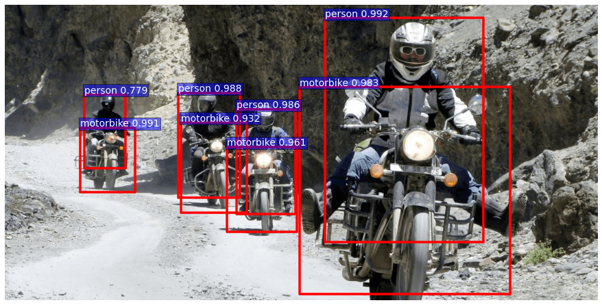
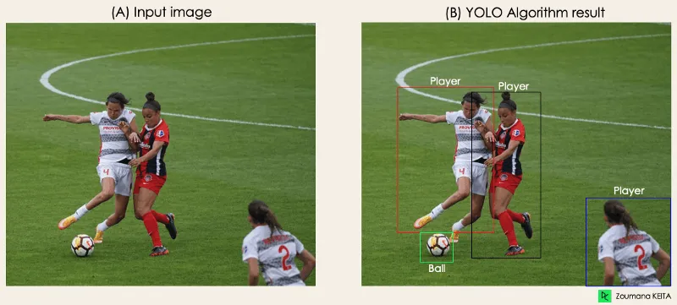
Retail Analytics: Object detection is used in retail environments for inventory management, customer tracking, and shelf monitoring. It helps retailers analyze customer behavior and optimize store layouts.
Medical Imaging: Object detection is applied in medical imaging for tasks such as tumor detection, organ segmentation, and anomaly detection. It aids radiologists in diagnosing diseases and conditions from medical images.
Augmented Reality: Object detection is utilized in augmented reality applications to recognize and interact with real-world objects, overlay digital content, and enhance user experiences in various contexts, such as gaming and education.

Slide 5
Introduction to YOLO:
Introduction to YOLO Algorithm and Significance in Object Detection:
YOLO is a popular object detection algorithm known for its speed and efficiency. It revolutionized object detection by introducing a single-stage architecture that can detect objects in real-time.
The significance of YOLO lies in its ability to perform object detection tasks quickly and accurately, making it suitable for various applications such as autonomous driving, surveillance, and robotics.
Concept of Single-Stage Object Detection and YOLO's Approach:
Traditional object detection approaches typically involve multiple stages, such as region proposal, feature extraction, and classification. These multi-stage methods can be computationally expensive and time-consuming.

Slide 6
YOLO, on the other hand, adopts a single-stage approach where object detection and classification are performed simultaneously. It divides the input image into a grid and predicts bounding boxes and class probabilities directly from the grid cells, resulting in a faster and more streamlined process.
YOLO differs from other approaches by eliminating the need for complex region proposal mechanisms and post-processing steps, making it more efficient and suitable for real-time applications.
Advantages of YOLO in Terms of Speed and Accuracy:
Speed: YOLO is renowned for its real-time performance, capable of processing images at a speed of over 30 frames per second (FPS) on standard hardware. Its single-stage architecture and efficient inference process enable rapid object detection without compromising accuracy.
Accuracy: Despite its speed, YOLO achieves competitive accuracy compared to traditional multi-stage approaches. By jointly optimizing object detection and classification in a single network, YOLO can effectively capture spatial and semantic information, leading to accurate object localization and classification results.
Overall, YOLO's combination of speed and accuracy makes it a compelling choice for various real-world applications where fast and reliable object detection is essential.

Slide 7
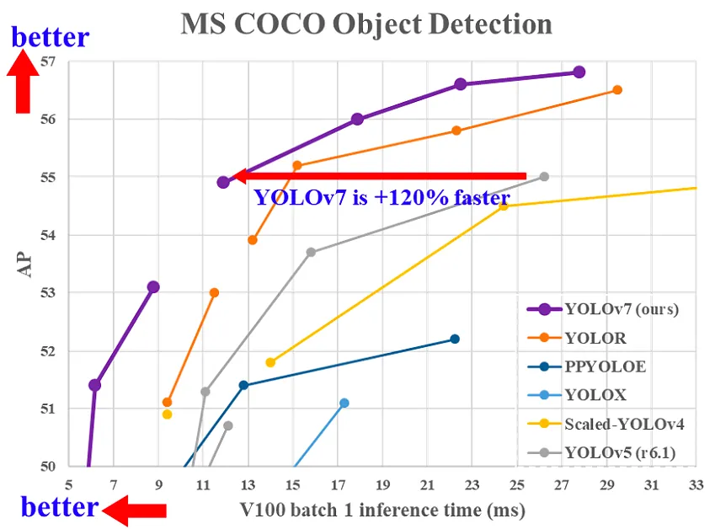
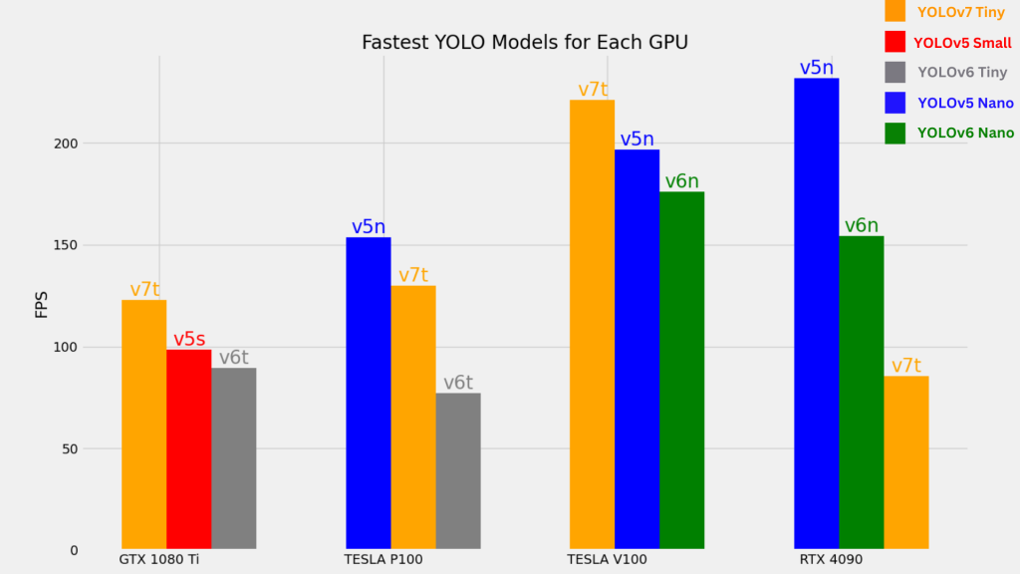

Slide 8
Training YOLOv7:
Dataset Preparation:
Gather a labeled dataset containing images along with corresponding bounding boxes and class labels for the objects of interest.
Ensure the dataset is diverse, representative of the real-world scenarios you want the model to perform well on, and sufficiently large to capture variations in object appearance, scale, and pose.
Data Preprocessing:
Normalize the input images to ensure consistent pixel values across the dataset. This typically involves scaling the pixel values to a fixed range (e.g., 0 to 1 or -1 to 1).
Resize the images to a uniform size to facilitate batch processing during training. YOLOv7 typically requires input images of a specific size, such as 416x416 pixels.
Optionally, apply data augmentation techniques such as random cropping, rotation, flipping, brightness adjustments, and color jittering to increase the diversity of the training data and improve model generalization.

Slide 9
Annotation:
Annotate the dataset with bounding boxes and class labels for each object of interest using annotation tools or software.
Ensure accurate and consistent annotations to provide reliable ground truth labels for training the model. Quality annotations are essential for the model to learn to detect objects accurately.
Model Configuration:
Choose the appropriate YOLOv7 configuration (e.g., YOLOv7-S, YOLOv7-M, YOLOv7-L, YOLOv7-X) based on your computational resources and application requirements. Larger models tend to offer better accuracy but require more computational power and training data.
Configure the model architecture, including the number of convolutional layers, filters, and output layers, based on the complexity of the detection task and the size of the dataset.
Training the Model:
Initialize the YOLOv7 model with pre-trained weights on a large-scale dataset (e.g., COCO dataset) to expedite convergence and improve performance.
Fine-tune the pre-trained model on your annotated dataset using gradient descent optimization algorithms such as stochastic gradient descent (SGD) or Adam.

Slide 10
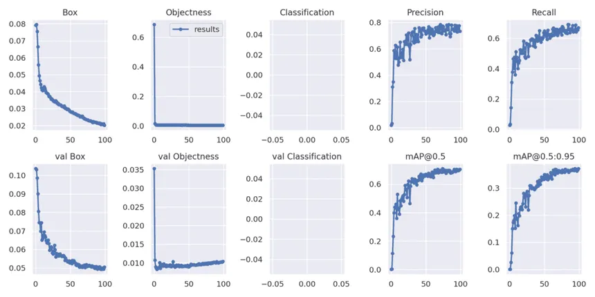
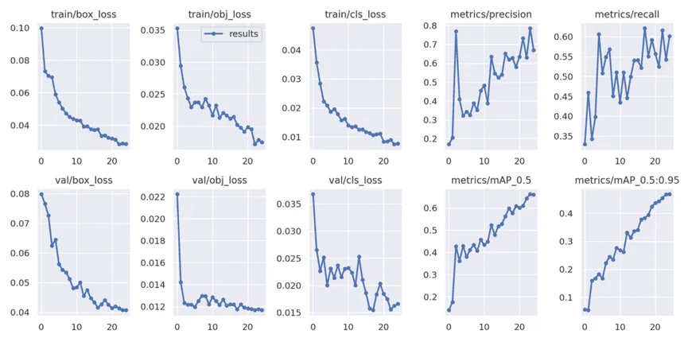
Hyperparameter Optimization:
Experiment with different hyperparameters such as learning rate, batch size, optimizer settings, and regularization techniques to find the optimal configuration that maximizes model performance.
Utilize techniques such as learning rate scheduling, early stopping, and model checkpointing to prevent overfitting and improve convergence.

Slide 11
Real-World Applications:
Autonomous Driving:
YOLOv7 is utilized in autonomous vehicles for real-time object detection, enabling vehicles to identify pedestrians, vehicles, cyclists, and other objects in their surroundings. It plays a critical role in ensuring the safety and efficiency of autonomous driving systems by providing accurate and timely information about the environment.
Surveillance Systems:
YOLOv7 is employed in surveillance cameras and security systems for detecting and tracking objects of interest, such as intruders, suspicious activities, and vehicles. It enables continuous monitoring of large areas and facilitates prompt responses to security threats.
Medical Imaging:
YOLOv7 is applied in medical imaging for tasks such as tumor detection, organ segmentation, and anomaly detection. It assists radiologists and healthcare professionals in analyzing medical images more efficiently and accurately, leading to improved diagnosis and treatment planning.
Industrial Automation:
YOLOv7 is employed in industrial automation and robotics for object detection and localization tasks in manufacturing, logistics, and warehouse management. It enables robots and automated systems to identify and manipulate objects, navigate environments, and perform tasks autonomously.

Slide 12
Traffic Management and Smart Cities:
YOLOv7 is utilized in smart city initiatives and traffic management systems for monitoring traffic flow, detecting accidents, and enforcing traffic regulations. It helps optimize transportation networks, improve road safety, and reduce congestion in urban areas.
Environmental Monitoring and Conservation:
In environmental monitoring and conservation efforts, YOLOv7 aids in identifying and tracking wildlife, monitoring biodiversity, and detecting illegal activities such as poaching and deforestation. It supports conservationists and environmental agencies in protecting endangered species and preserving natural habitats.
Conclusion:
In conclusion, YOLOv7 stands as a testament to the relentless pursuit of excellence in computer vision, offering unprecedented speed, accuracy, and versatility in object detection. As we look ahead, let us embrace the opportunities presented by YOLOv7 to push the boundaries of what is possible in the realm of object detection and continue advancing the field for the betterment of society.

Slide 13
ThankYou:
-BY:
Akshay.
Adithya.
Akhil.
AbdulRazaq.
Godwin.

